Slide 1
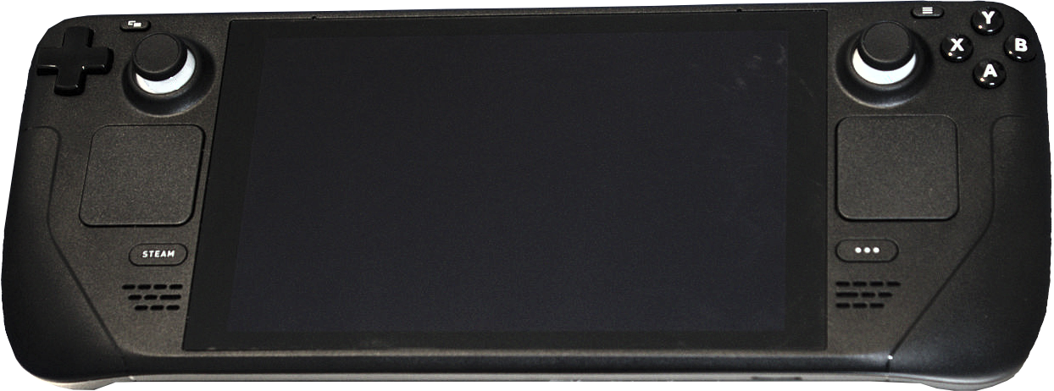
Jeden rok se Steam Deckem
Michal Konečný
E-mail: michal.konecny@pacse.eu
Matrix: @zlopez:matrix.org

Slide 2
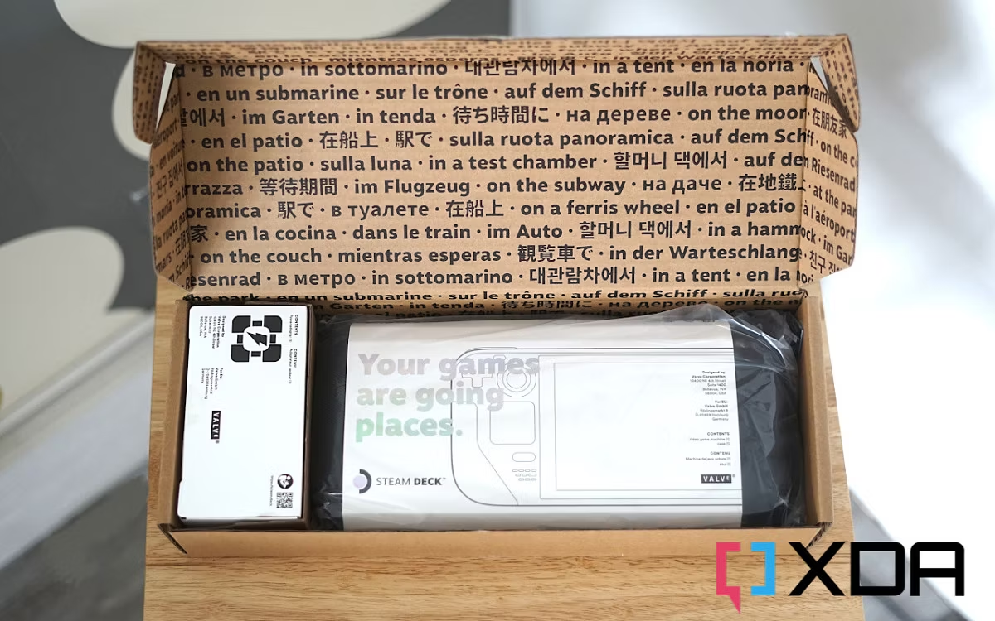

Slide 3
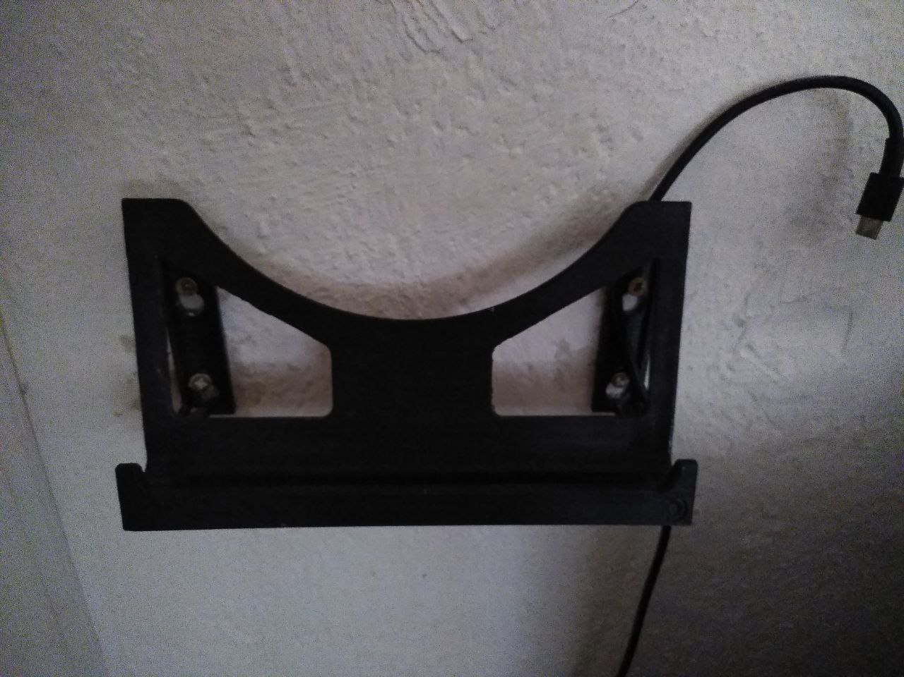
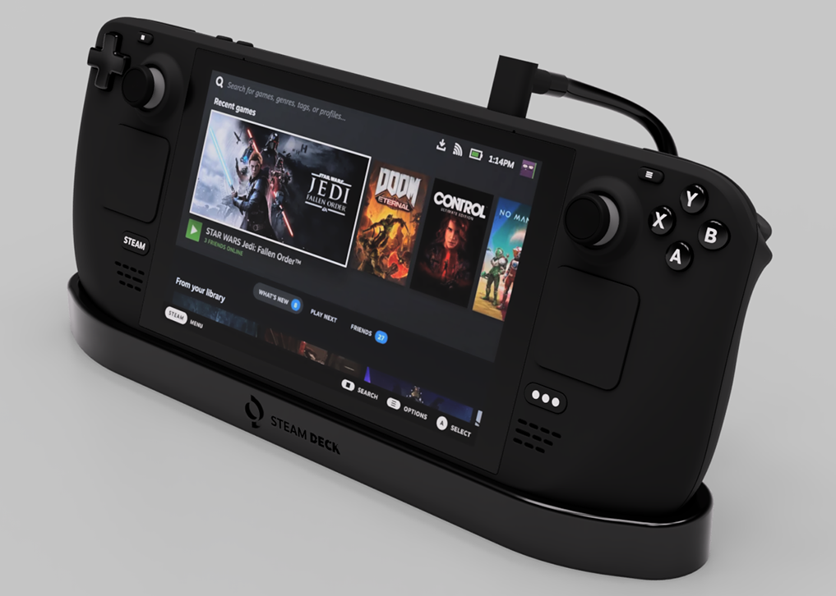
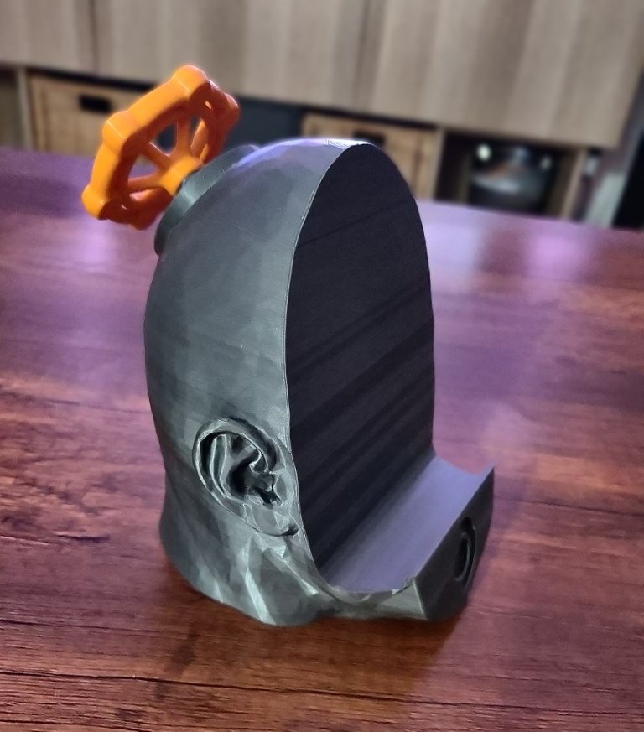
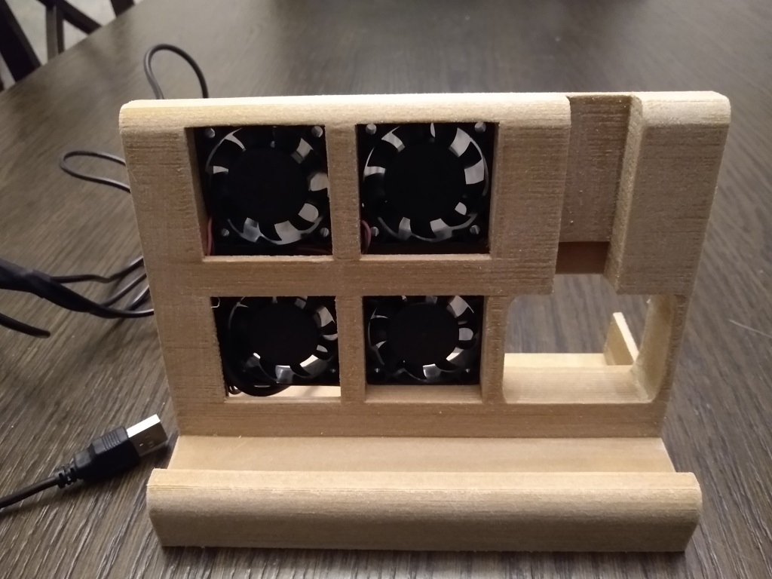

https://www.thingiverse.com/

Slide 4
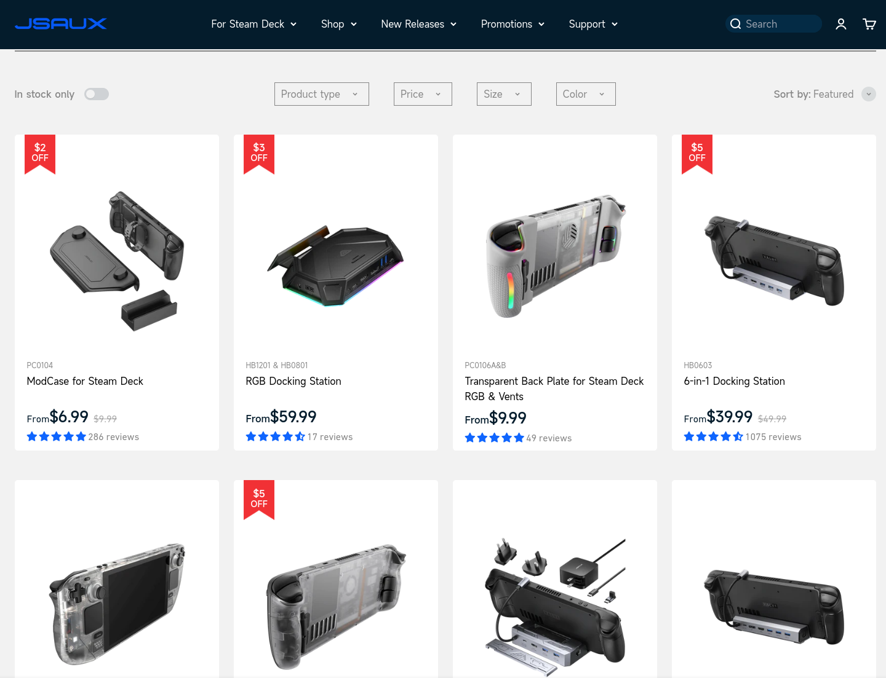
https://jsaux.com/collections/steam-deck-accessories

Slide 5
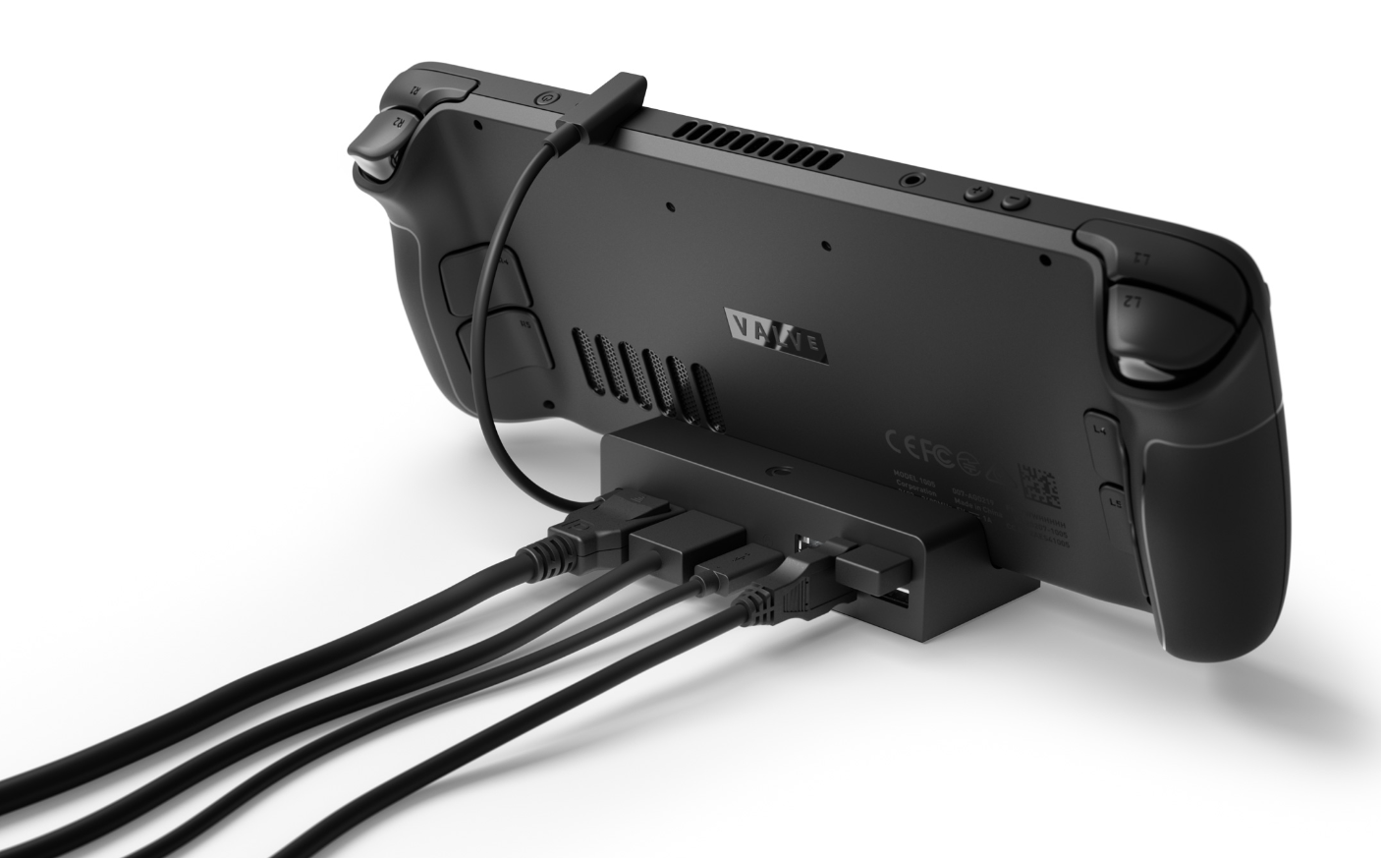
https://www.steamdeck.com/en/hardware

Slide 6
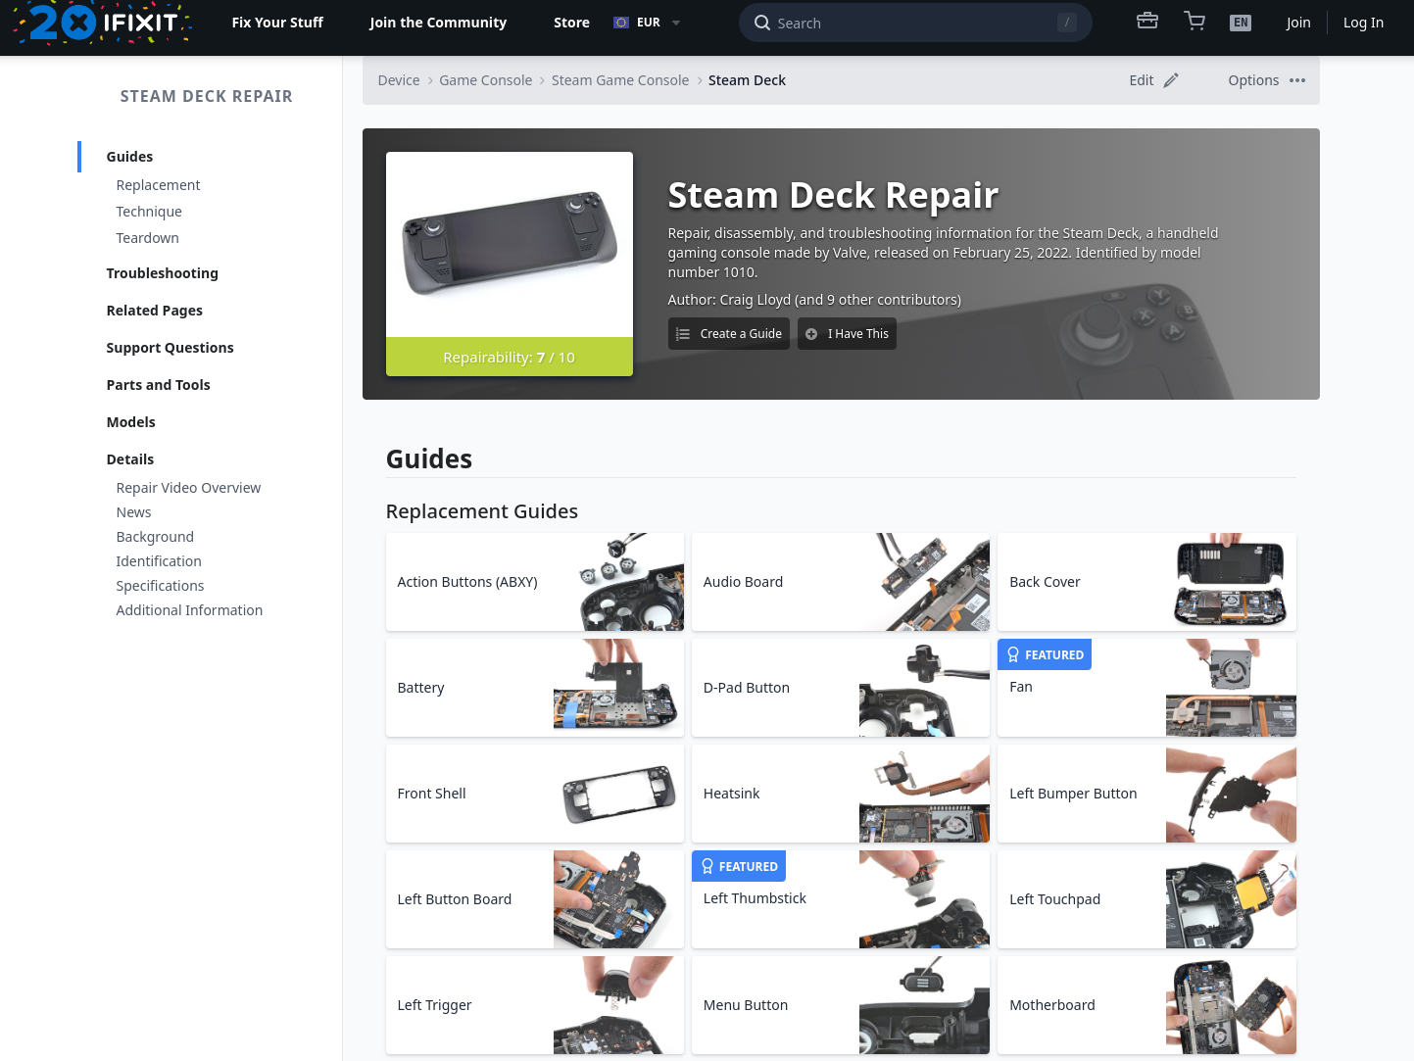
https://www.ifixit.com/Device/Steam_Deck

Slide 7
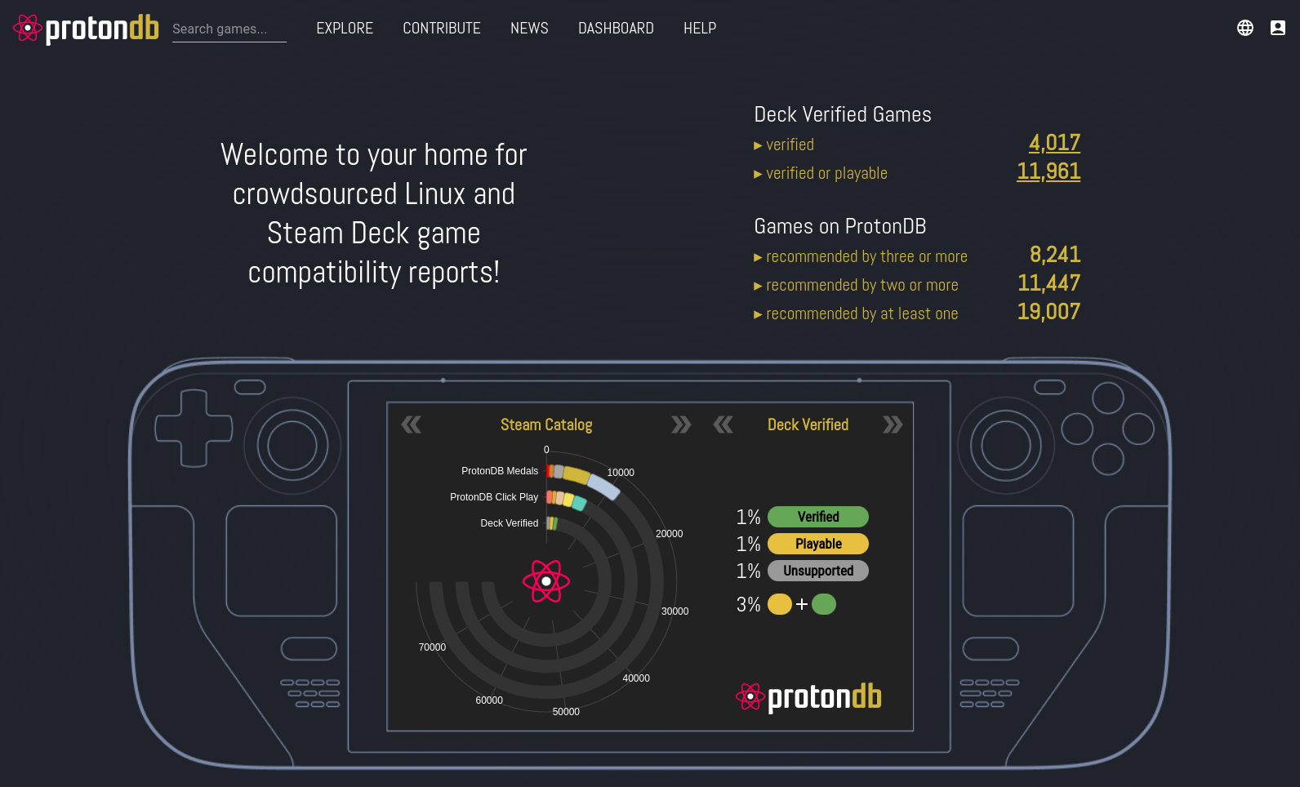
https://www.protondb.com/

Slide 8
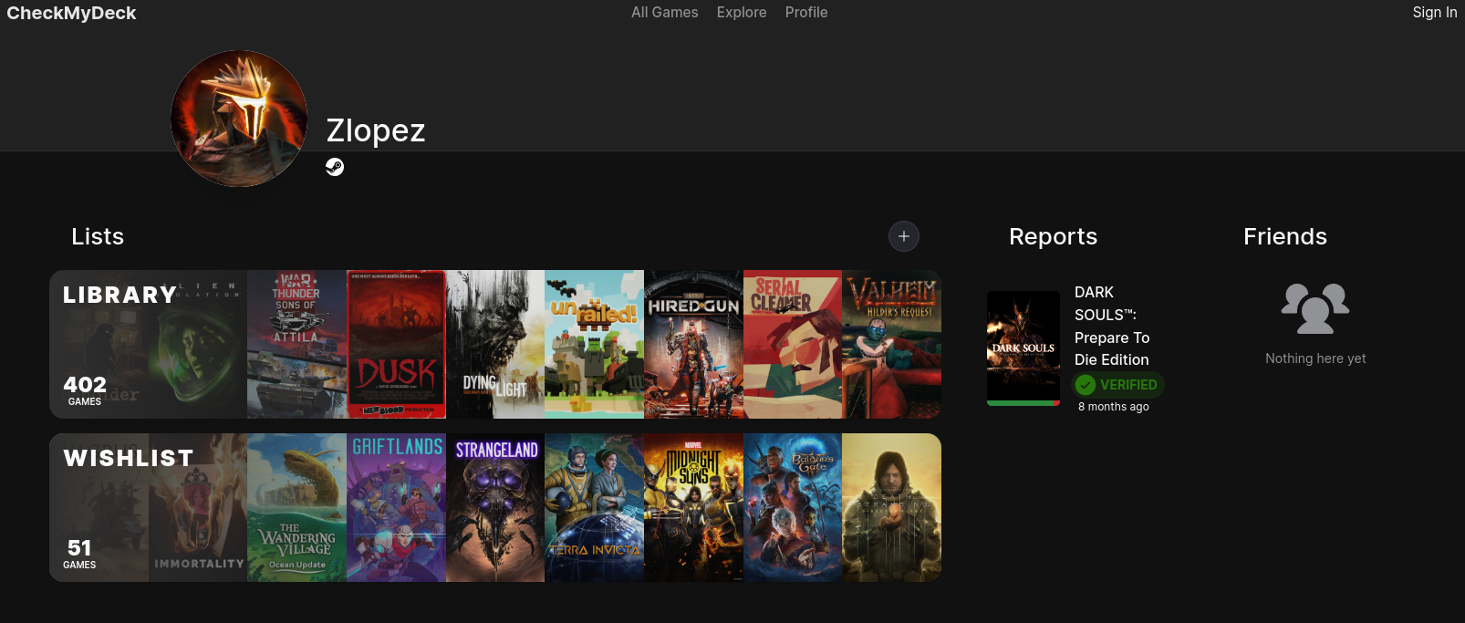
https://checkmydeck.ofdgn.com/

Slide 9
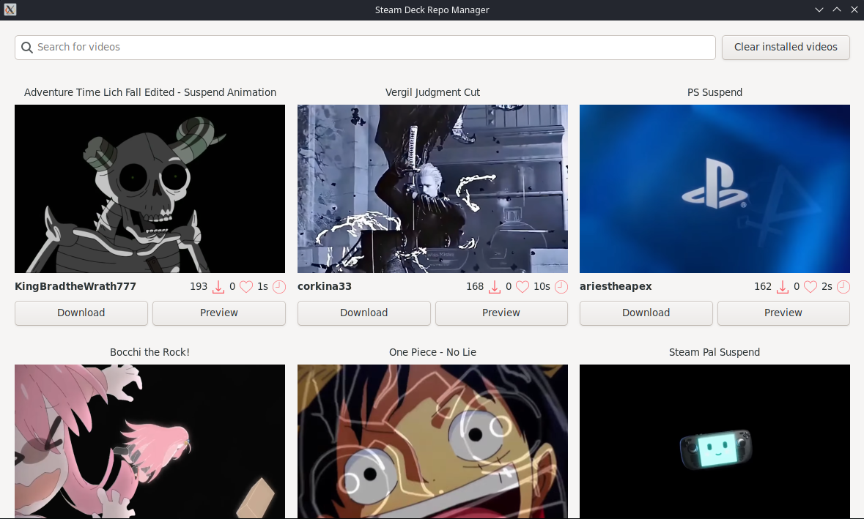
https://flathub.org/apps/com.steamdeckrepo.manager

Slide 10
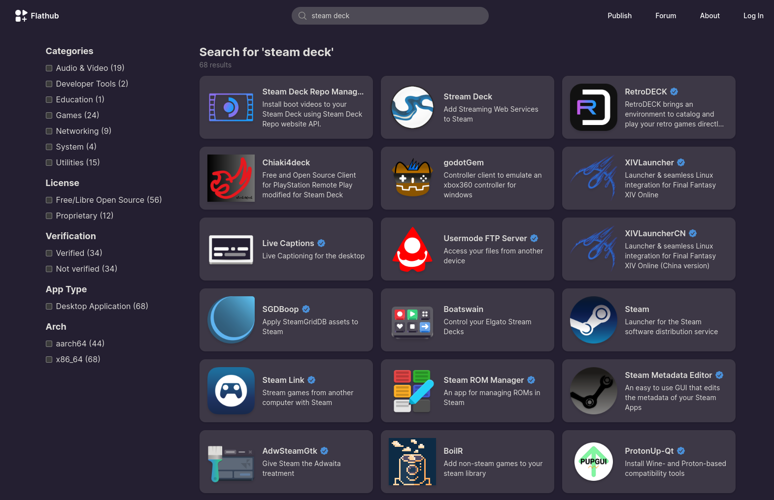
https://flathub.org/

Slide 11
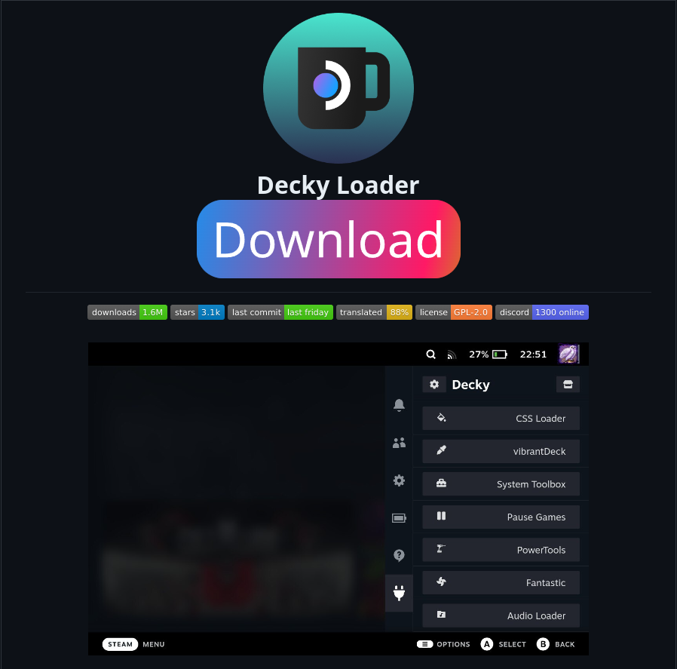
https://github.com/SteamDeckHomebrew/decky-loader

Slide 12
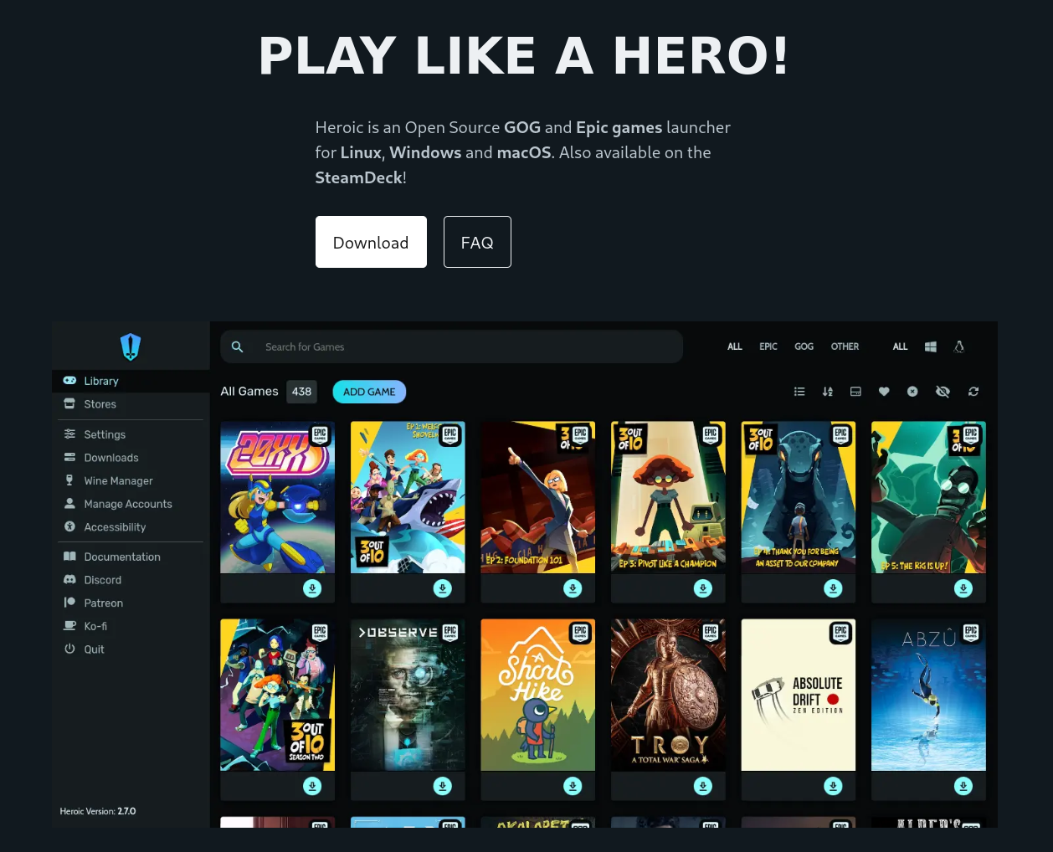
https://heroicgameslauncher.com/

Slide 13
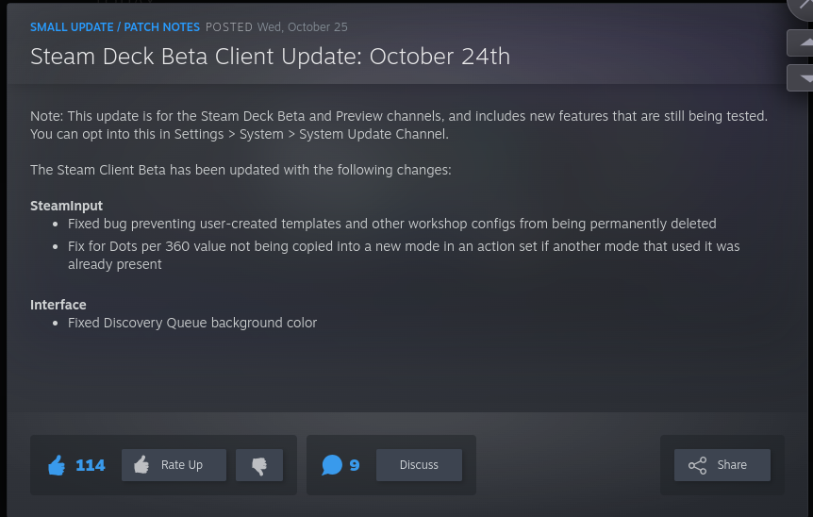
https://store.steampowered.com/news

Slide 14
Osobní zkušenosti

Slide 15
Děkuji za pozornost!

